Slide 1
Employee Data Analysis using Excel
STUDENT NAME: Akilandeshwari V
REGISTER NO: 312216091 NM ID:asunm1621312216091
DEPARTMENT: BCom Accounting and Finance
COLLEGE: Shri Shankarlal Sundarbai Shasun Jain
College For Women.

Slide 2
PROJECT TITLE
Employee Performance Analysis using Excel

Slide 3
AGENDA
Problem Statement
Project Overview
End Users
Our Solution and Proposition
Dataset Description
Modelling Approach
Results and Discussion
Conclusion

Slide 4

PROBLEM STATEMENT
An employee performance review is an evaluation where managers, peers, or other stakeholders assess a team member’s job performance over time.
An employee performance review is one of the best ways to identify what’s working—and what can be improved.

Slide 5

PROJECT OVERVIEW
A performance review is a two-way conversation between an employee and their manager to discuss their strengths, quality of work, and growth.
The goal is to provide insights into the factors affecting employee performance, identify department-wise performances, and develop a machine learning model that predicts employee performance ratings. The insights gained from this analysis can be used for informed hiring decisions and strategies to enhance employee performance.

Slide 6
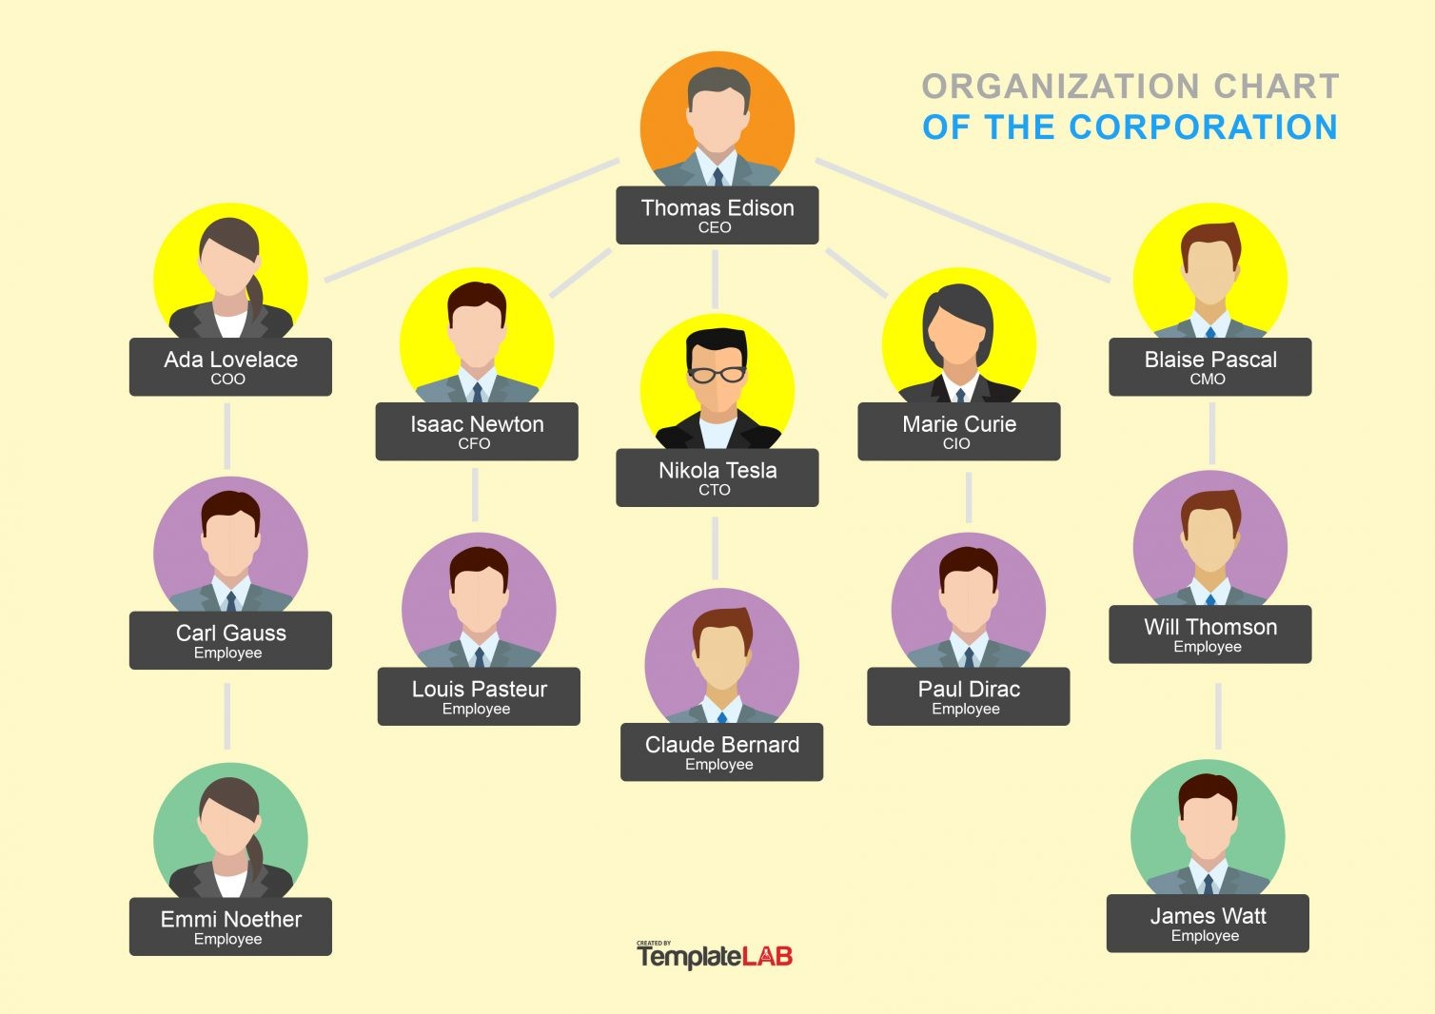





WHO ARE THE END USERS?

Slide 7

OUR SOLUTION AND ITS VALUE PROPOSITION
Conditional formatting- Missing
Filter- Remove
Formula- Performance
Pivot table- Summary
Graph- Data Visualization

Slide 8
Dataset Description
Employee Data- Kaggle
26 Features
9 Features
Employee id- Numerical value
Name- Text
Employee Type
Performance level
Gender- Male Female
Employee Rating- Numerical value

Slide 9

THE "WOW" IN OUR SOLUTION
Analyzing performance data in Excel using Array formula and dynamic range name methods.The recording and analysis of performance data is the quintessential spreadsheet application.
FORMULA=IFS(I2>=5,"VERY
HIGH",I2>=4,"HIGH",I2>=3,"MED",TRUE,"LOW")

Slide 10
MODELLING
DATA COLLECTION
Data Organization
Data Validation
DATA MODELLING
Key Performance
Pivot table
DATA CLEANING
Missing values
Filter
PERFORMANCE LEVEL
Employee Rating
Formula=IFS(I4>=5,"VERY HIGH",I4>=4,"HIGH",I4>=3,"MED",TRUE,"LOW")

Slide 11
MODELLING
VISUALIZATION
Chart
Graphs
Trends
SCENARIO ANAYSIS
What-if Analysis
Trend Analysis
REPORTING
Automated Reports
Custom Reports

Slide 12
RESULTS

Slide 13
RESULTS

Slide 14
Conclusion
The largest segment is NEL at 18%, indicating it has the highest proportion among the categories. The smallest segment is TNS at 7%. The other categories are fairly evenly distributed, with most ranging between 9% and 11%.
The exponential trend line for ‘Low’ performance and the linear trend line for ‘Medium’ performance indicate potential areas for improvement.

Slide 15
CONCLUSION
Targeted Training Programs: Implement training programs focused on the skills and areas where low performance is prevalent. For example, units like BPC and WBL could benefit from additional training and support.
Regular Feedback and Mentoring: Establish a system for regular feedback and mentoring to help employees understand their performance and areas for improvement.
Recognition and Rewards: Recognize and reward high-performing employees to maintain morale and encourage others. This can be done through bonuses, promotions, or public recognition.

